Slide 1
Autoencoders for mSEM artifact detection

Slide 2
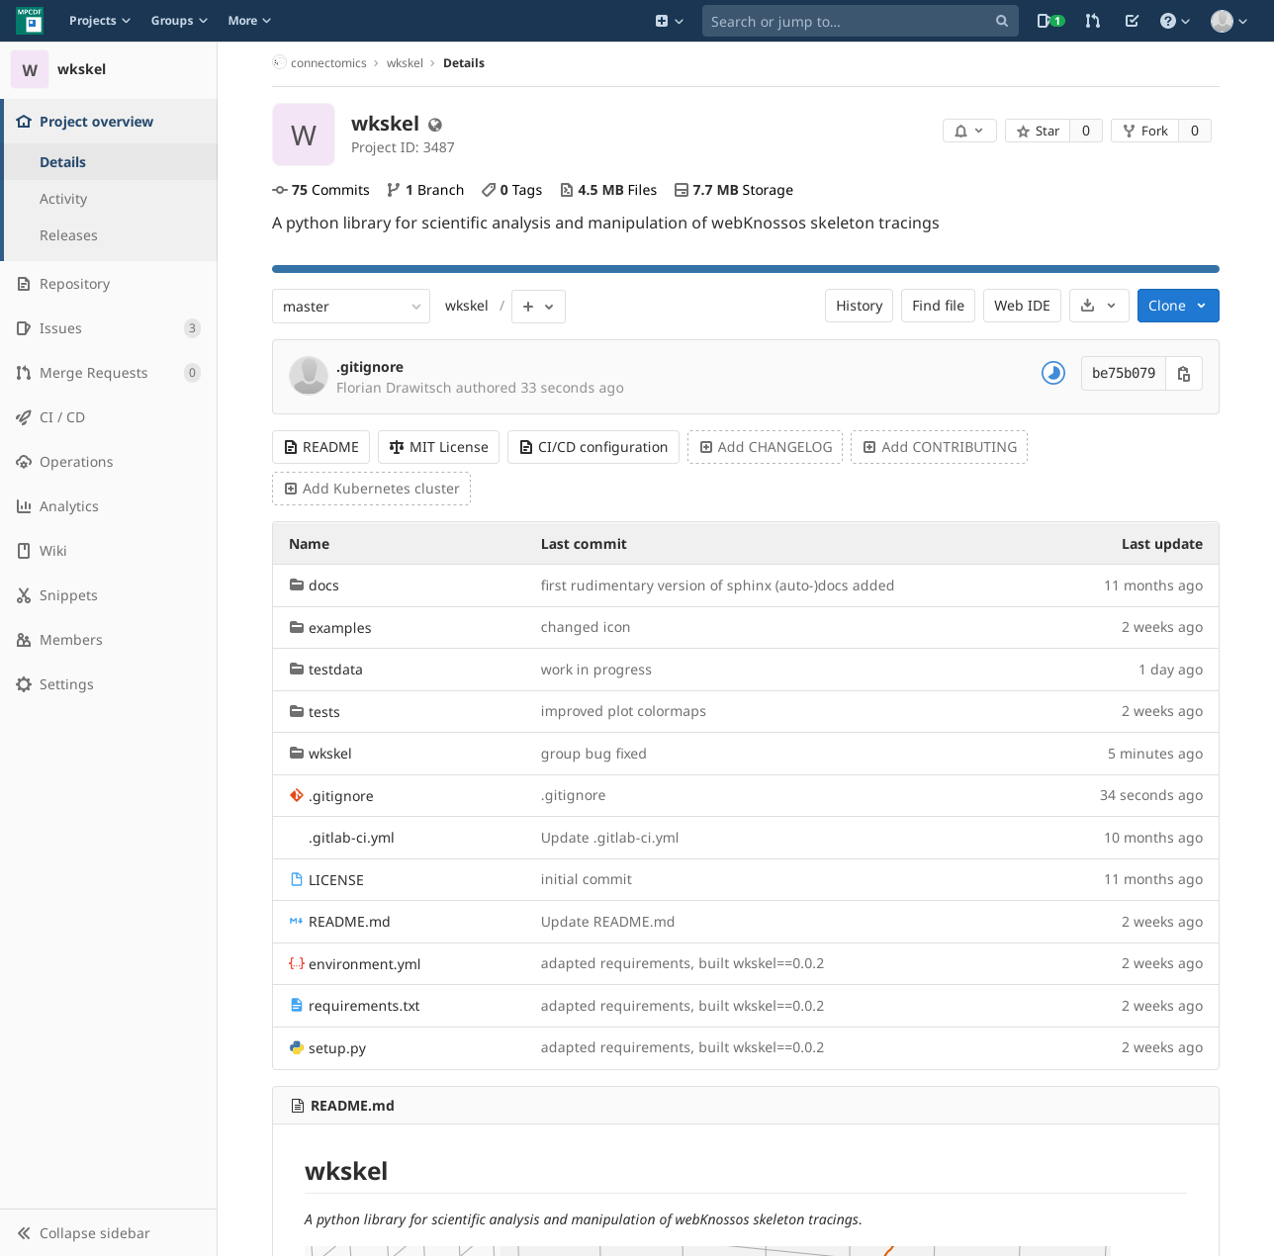
Call for contributions: wkskel
wkskel: python library for skeleton manipulation
Developed on the side from scratch
Most important functionality is there
Porting full functionality & performance of matlab skeleton class is a lot of work
Please help by using, improving & documenting it
Two contribution strategies possible:
Direct commits to master: Please write test for your method (repo has gitlab ci/cd set up)
Pull requests
How to install it:
$ pip install wkskel
How to use it:
Jupyter notebook tutorial: https://gitlab.mpcdf.mpg.de/connectomics/wkskel:examples

Slide 3
Autoencoders for mSEM artifact detection

Slide 4
mSEM artifacts: general
mSEM artifacts are a problem for automated downstream analysis -> hinder classification / segmentation / agglomeration
mSEM artifacts come in various forms and are difficult to detect reliably using humans or hand-designed algorithms
Variety of artifacts and large data size
Problematic situation for classical supervised approaches (e.g. U-net)
Training a naive U-net or similar (>E6 params) in a supervised fashion would require HUGE amount of labeled training data

Slide 5
mSEM artifacts: data situation
Huge amount of unlabeled data (even in mag-8-8-1 ~1TB)
Much less labeled data (> 500 training patches ~ 10MB):
Lablog Summary: https://mhlablog.net/2020/02/05/training-data-for-artefact-detection-in-msem-data/
Circular Artifact: https://webknossos.brain.mpg.de/annotations/Explorational/5e387a00010000501b1a41bd#25238,20546,3546,0,0.513,1
Horse shoe Artifact: https://webknossos.brain.mpg.de/annotations/Explorational/5e387a00010000501b1a41bd#19895,15530,3732,0,0.513,12
Scratch Artifact: https://webknossos.brain.mpg.de/annotations/Explorational/5e387a00010000501b1a41bd#20088,16049,3925,0,0.513,17

Slide 6
Supervised CNN vs. unsupervised autoencoder (AE)
CNN
f: X ⟶ Y
y = f’(x) + ε
Min_{p}Loss(f’_{p}(x) - y)
----------------------
class CNN:
def predict(x):
y_hat = f(x)
return y_hat
AE
e: X ⟶ L
d: L ⟶ X
x = d’(e’(x)) + ε
Min_{p}Loss(d’_{p}(e’_{p}(x)) - x)
---------------------
class AE:
def predict(x)
x_hat = d(e(x))
return x_hat

Slide 7
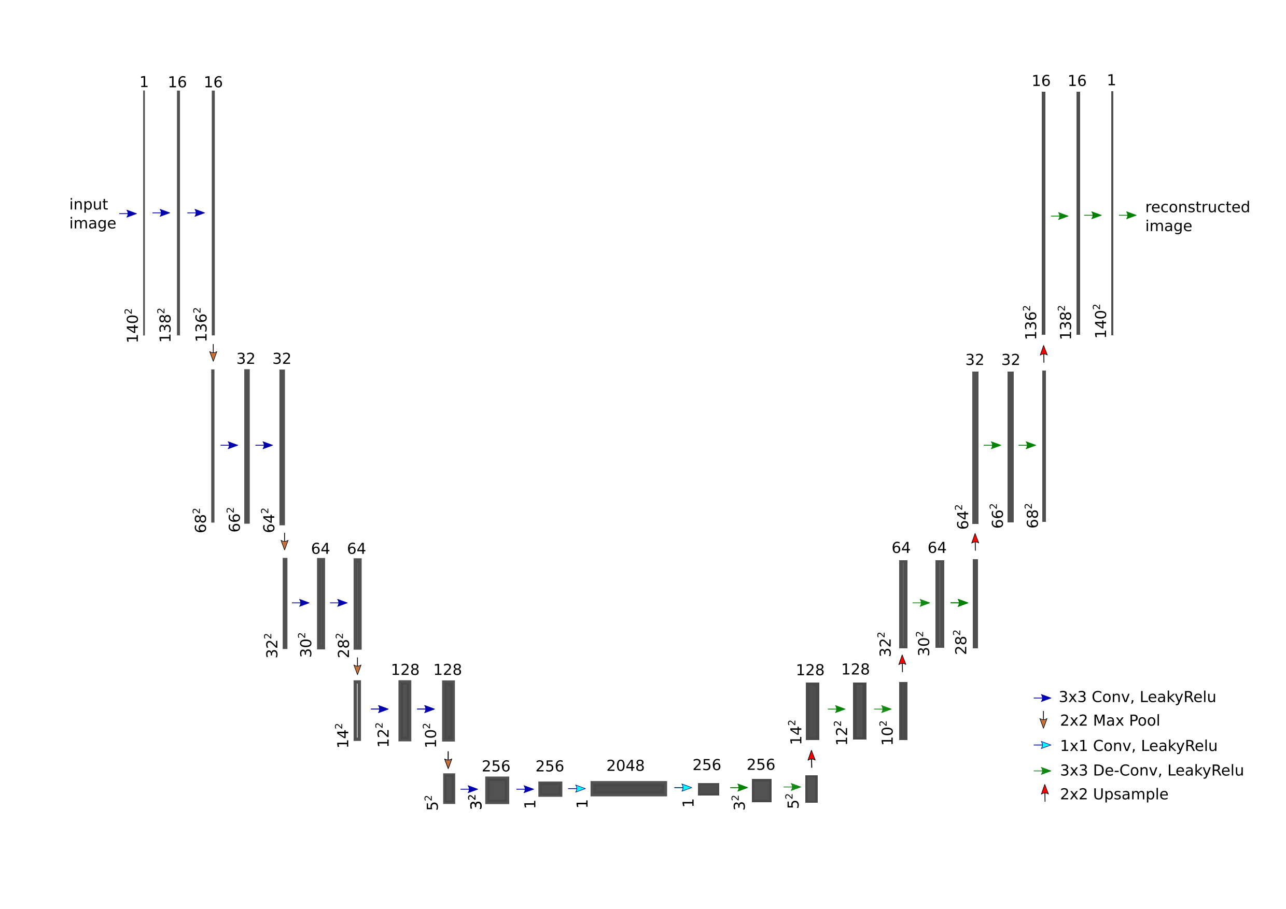
Basic multi-res AE for mSEM data

Slide 8
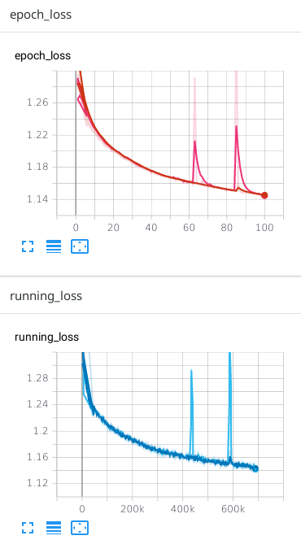
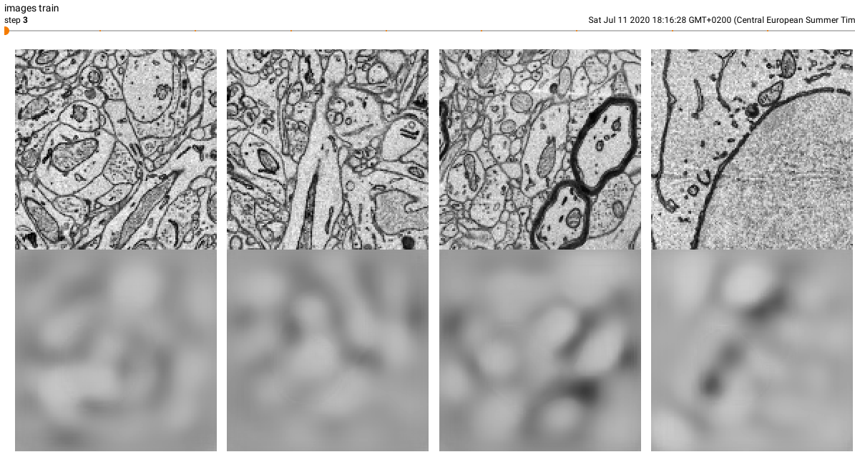
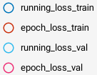
Basic multi-res AE for mSEM data

Slide 9
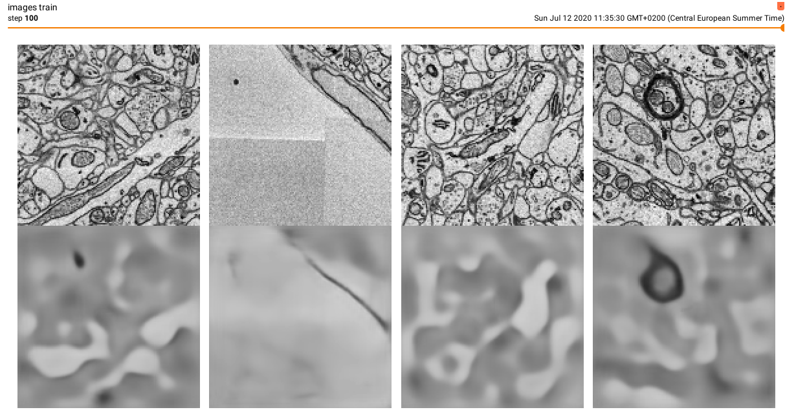
Basic multi-res AE for mSEM data

Slide 10
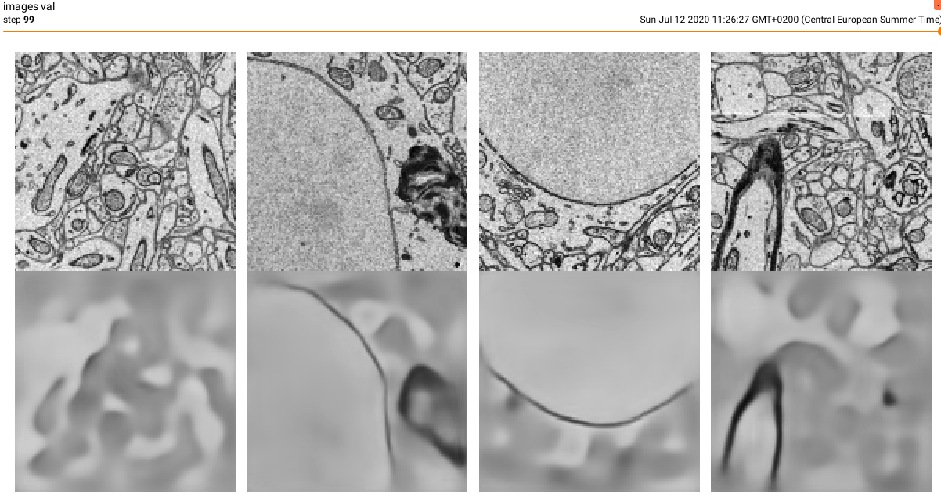
Basic multi-res AE for mSEM data

Slide 11
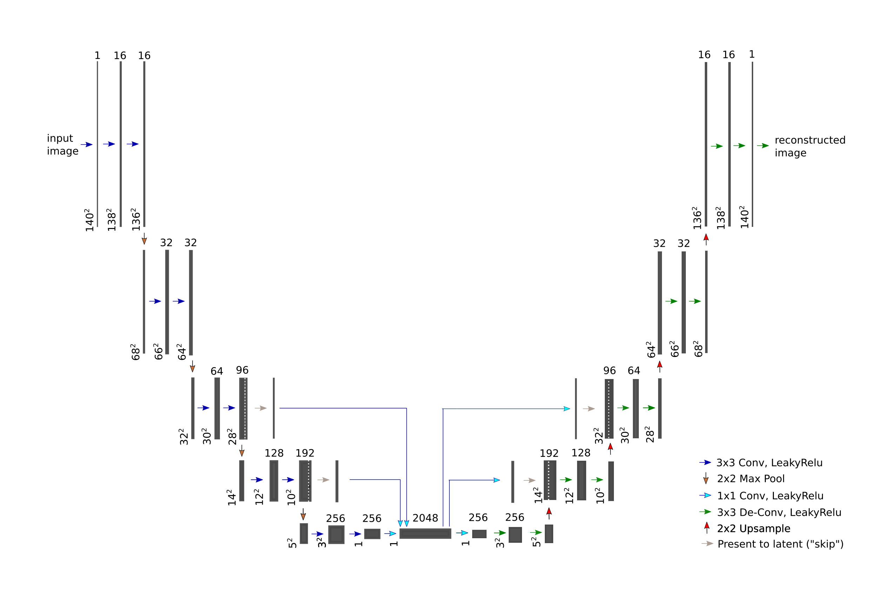
Multi-res “skip” AE for mSEM data

Slide 12
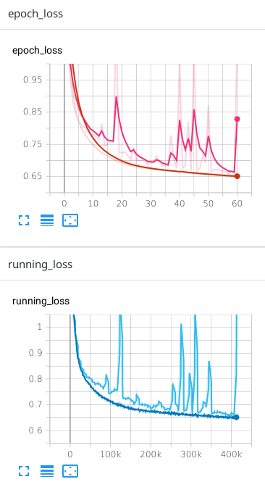
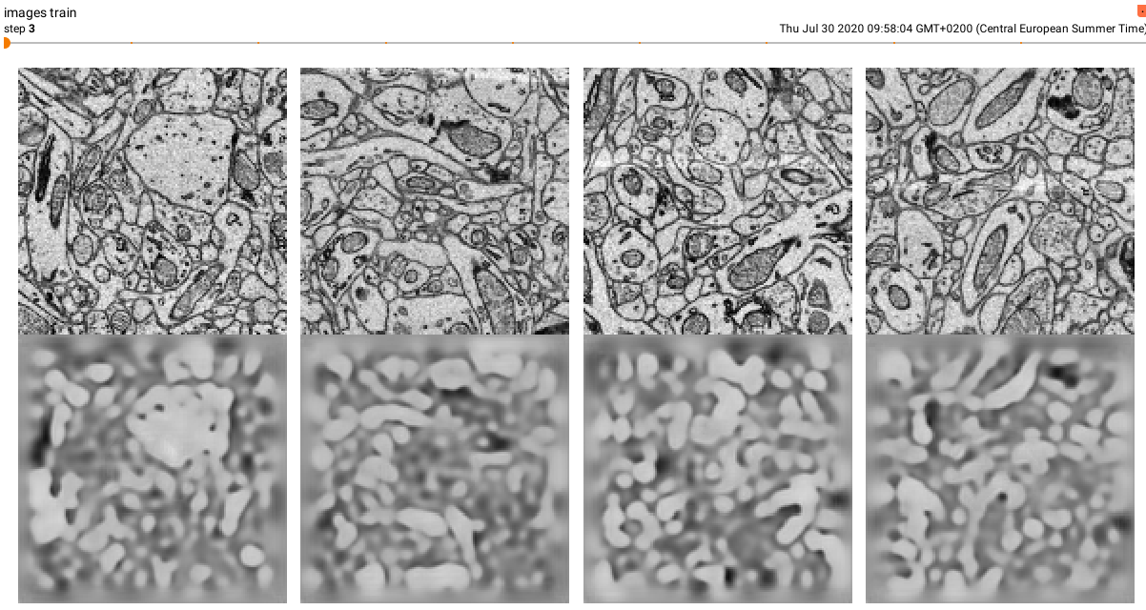
Multi-res “skip” AE for mSEM data

Slide 13
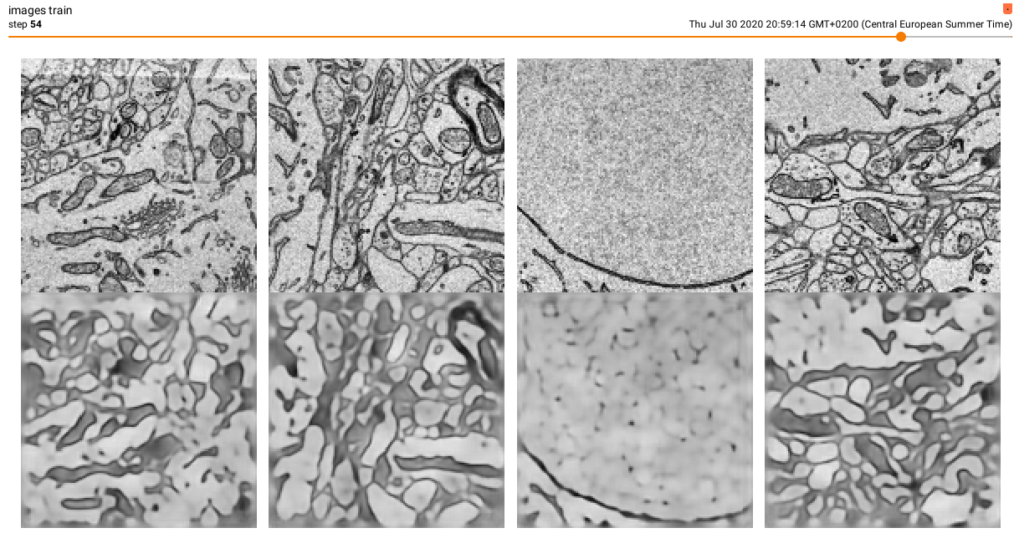
Multi-res “skip” AE for mSEM data

Slide 14
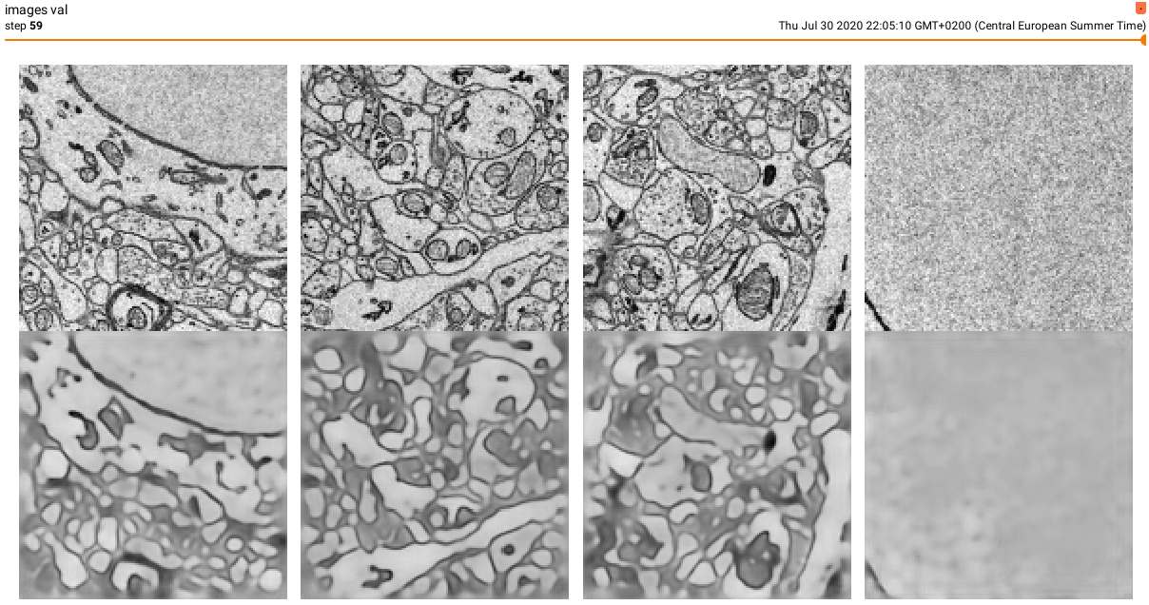
Multi-res “skip” AE for mSEM data

Slide 15
Multi-res “skip” AE for mSEM data

Slide 16
Unsupervised AE vs. semi-supervised encoder + classifier
AE
e: X ⟶ L
d: L ⟶ X
x = d’(e’(x)) + ε
Min_{p}Loss(d’_{p}(e’_{p}(x)) - x)
---------------------
class AE:
def predict(x)
x_hat = d(e(x))
return x_hat
Encoder + classifier
e: X ⟶ L
c: L ⟶ Y
y = c’(e’(x)) + ε
Min_{p}Loss(c’_{p}(e’(x)) - x)
---------------------
class EncoderClassifier:
def predict(x)
y_hat = c(e(x))
return y_hat

Slide 17
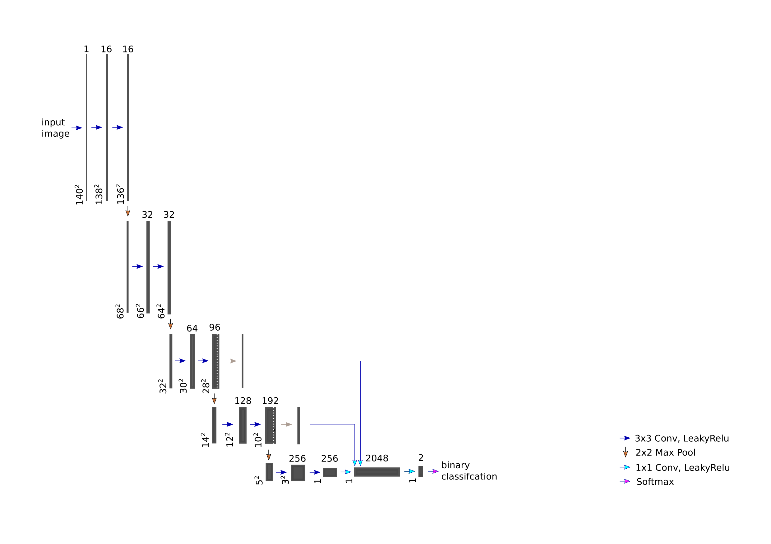
Multi-res “skip” encoder + binary classifier for mSEM data
Encoder:
Freeze weights (keep weights learnt unsupervised)
Classifier:
Learn weights (given labels)

Slide 18
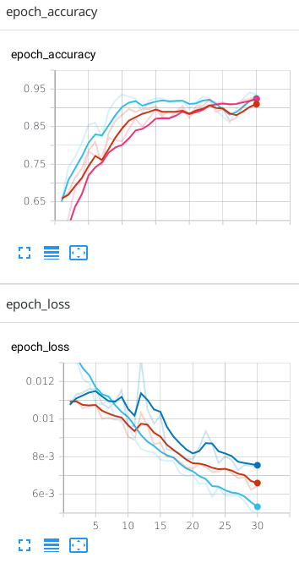
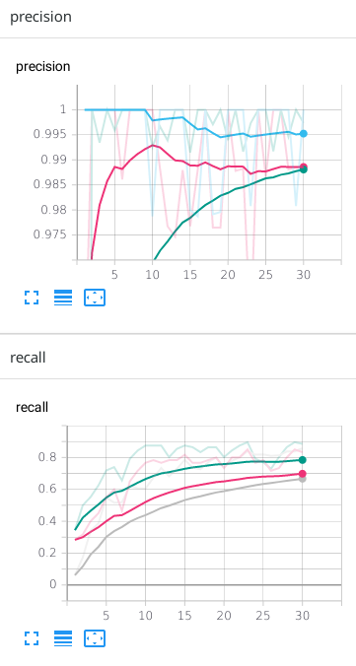
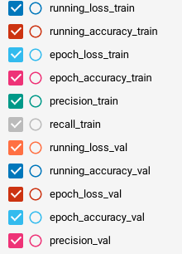
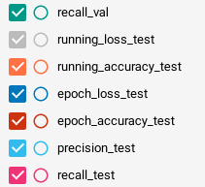
Multi-res “skip” encoder + binary classifier for mSEM data

Slide 19
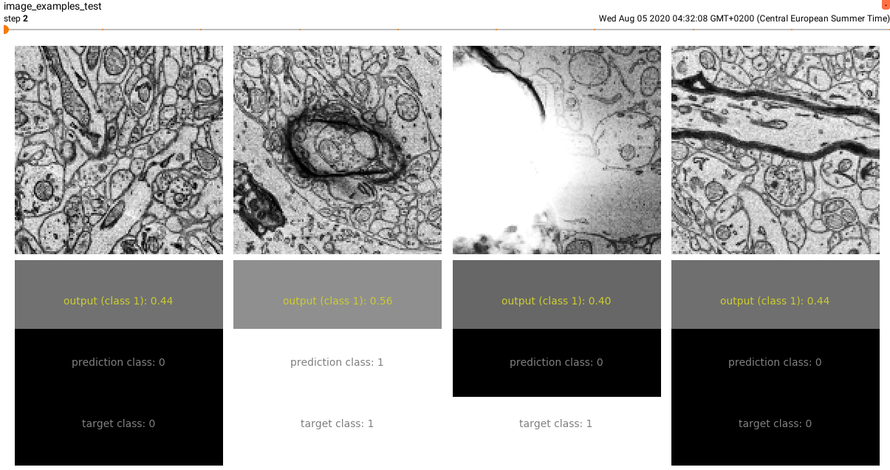
Multi-res “skip” encoder + binary classifier for mSEM data

Slide 20
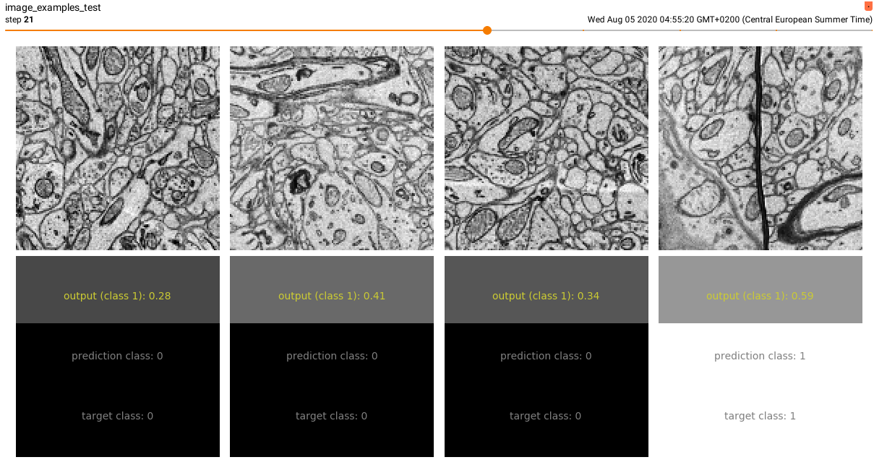
Multi-res “skip” encoder + binary classifier for mSEM data

Slide 21
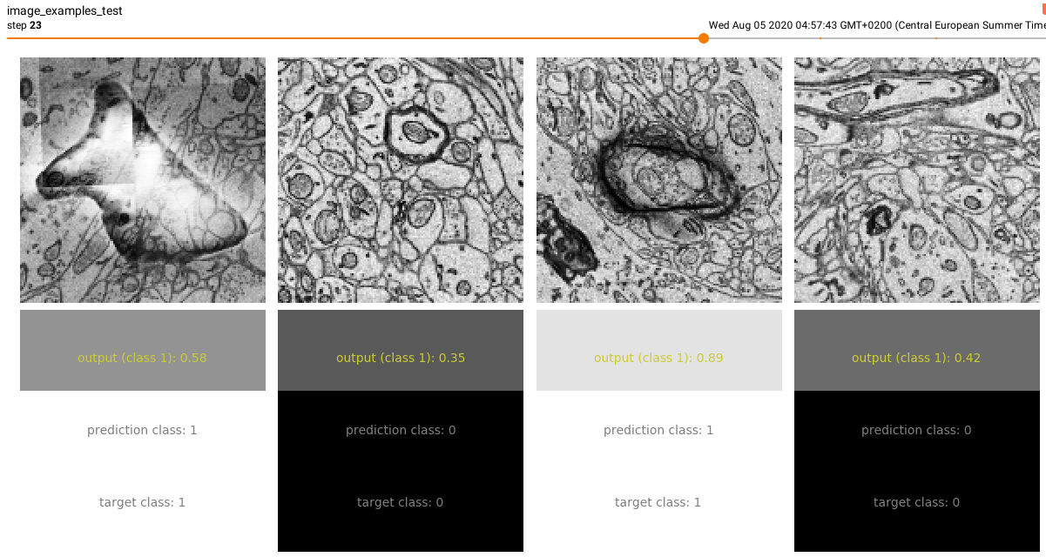
Multi-res “skip” encoder + binary classifier for mSEM data

Slide 22
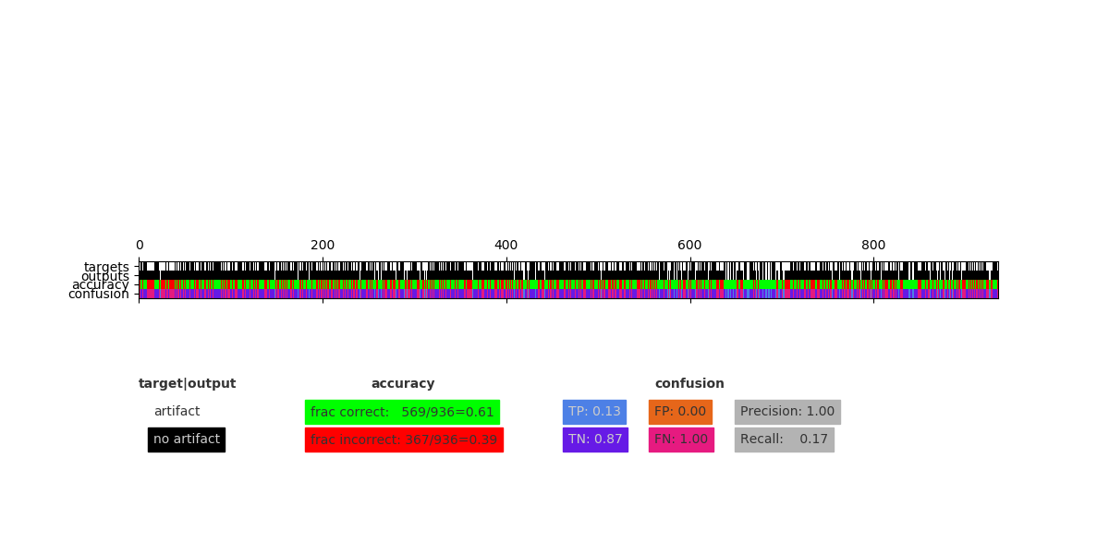
Multi-res “skip” encoder + binary classifier for mSEM data

Slide 23
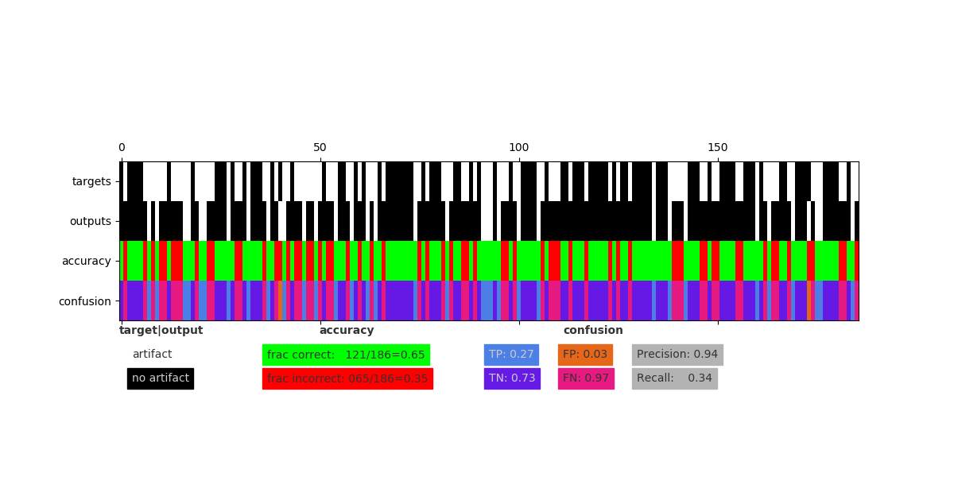
Multi-res “skip” encoder + binary classifier for mSEM data

Slide 24
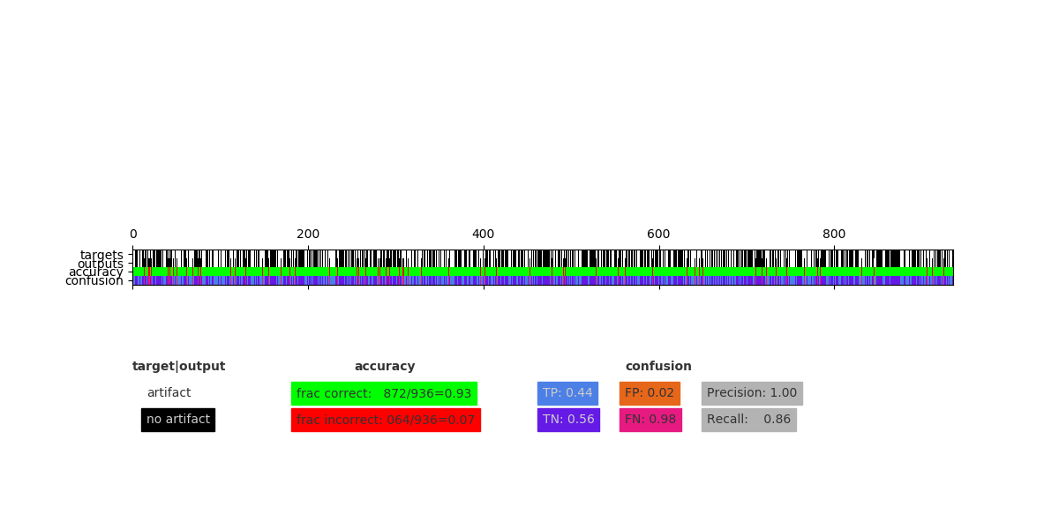
Multi-res “skip” encoder + binary classifier for mSEM data

Slide 25
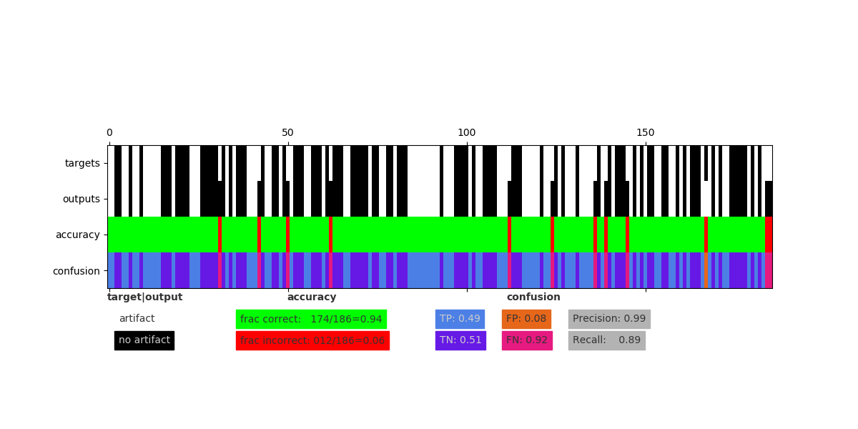
Multi-res “skip” encoder + binary classifier for mSEM data

Slide 26
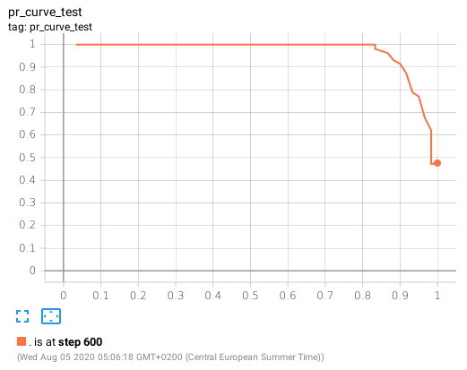
Multi-res “skip” encoder + binary classifier for mSEM data

Slide 27
Improving the model
How to get pr curve up?
Increase amount of training data
Increase variation in training data / augmentation
Increase complexity of classifier network

Slide 28
Interlude: Data architecture
mSEM data
wkw files on
gaba fileserver
Datasource.json
{
"datasource_0": {
"id": 0,
"input_path": "/tmpscratch/webknossos/Connectomics_Department/dsXXXX/color/1",
"input_bbox": [
28672,
24576,
5120,
1024,
1024,
1024
],
"input_mean": 148.0,
"input_std": 36.0,
"target_path": …
}
defines pointers to wkw subvolumes & attributes
reads
maps
Pytorch dataloader
Pytorch dataset
HDD & RAM cache
loads (eager/cache)
writes (eager/cache)
predicts
loads
Pytorch model

Slide 29
Improving the model: Increase train data amount & variation
mSEM data
wkw files on
gaba fileserver
Datasource.json
{
"datasource_0": {
"id": 0,
"input_path": "/tmpscratch/webknossos/Connectomics_Department/dsXXXX/color/1",
"input_bbox": [
28672,
24576,
5120,
1024,
1024,
1024
],
"input_mean": 148.0,
"input_std": 36.0,
"target_path": …
}
defines pointers to wkw subvolumes & attributes
“Wiggle” existing training patches
Translate data pointers:
x’ = x +/- 35 px
y’ = y +/- 35 px
Should increase robustness for off-center artifacts
reads
maps
Pytorch dataloader
Pytorch dataset
HDD & RAM cache
loads (eager/cache)
writes (eager/cache)
Dataset
Total: 8562 (140x140x1) labelled samples
Train: 7276 (2545 artifact, 4731 no artifact)
Validation: 1284 (454 artifact, 829 no artifact)
-> counts include wiggles
-> counts do not take into account random augmentations
predicts
loads
Augment training patches on the fly
rand rot90*k; k=[0,3]; p=0.25
rand flip u/d; p=0.5
rand flip l/r; p=0.5
Pytorch model

Slide 30
Improving the model: previous classifier complexity
Encoder:
Freeze weights (keep weights learnt unsupervised)
Classifier:
Learn weights (given labels)

Slide 31
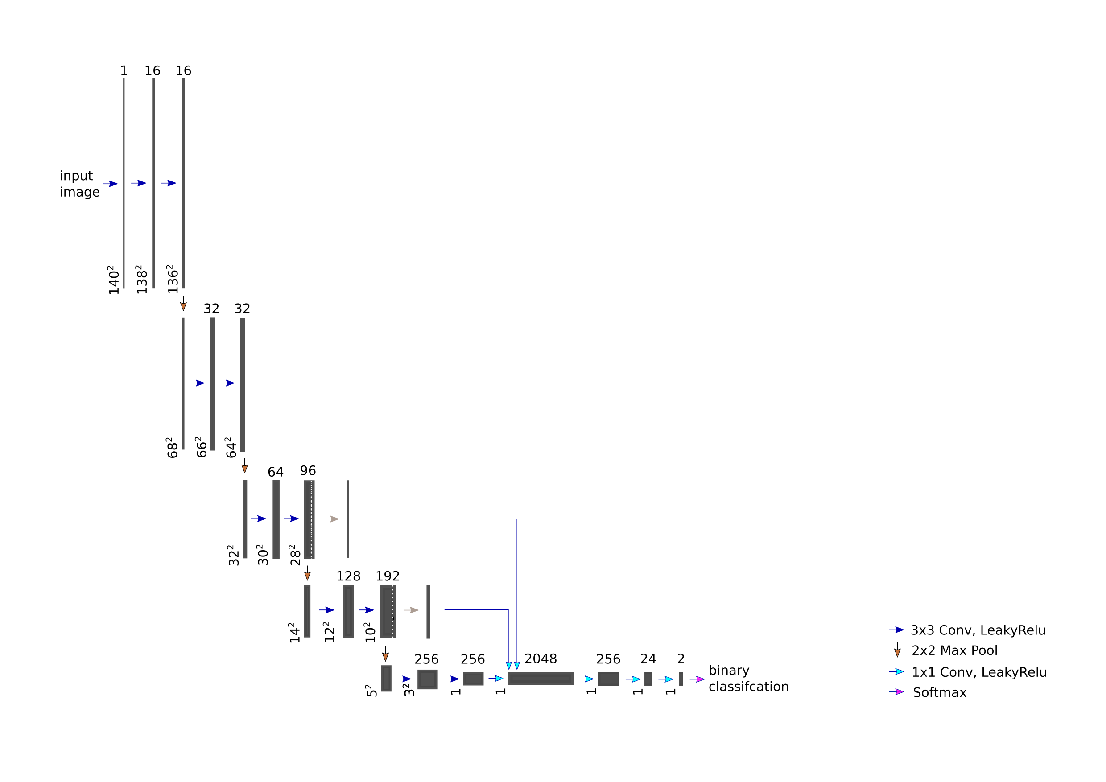
Improving the model: increased classifier complexity
Encoder:
Freeze weights (keep weights learnt unsupervised)
Classifier:
Learn weights (given labels)

Slide 32
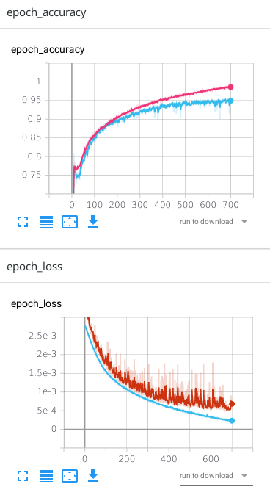
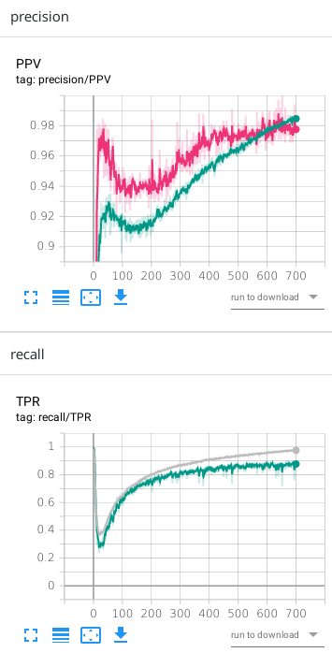
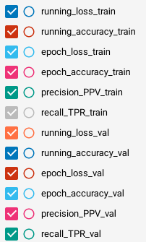
Improving the model: training performance

Slide 33
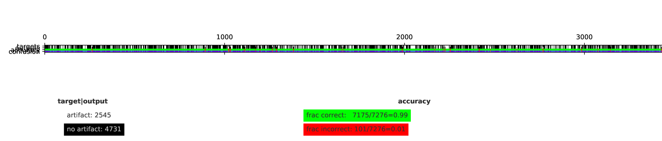
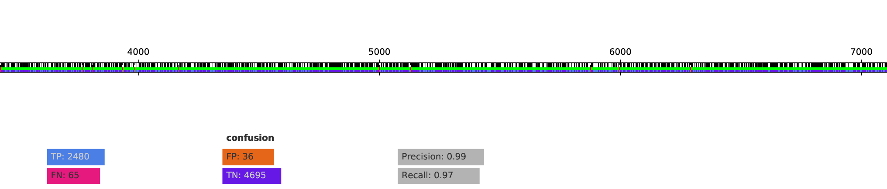
Improving the model: training performance (train set)

Slide 34
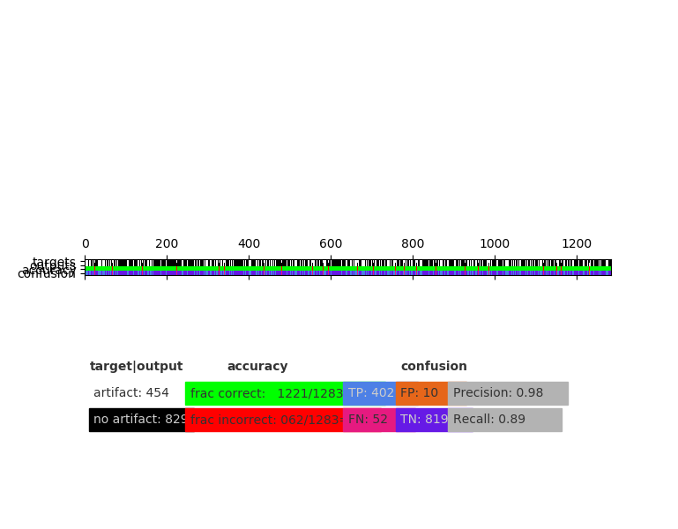
Improving the model: training performance (val set)

Slide 35
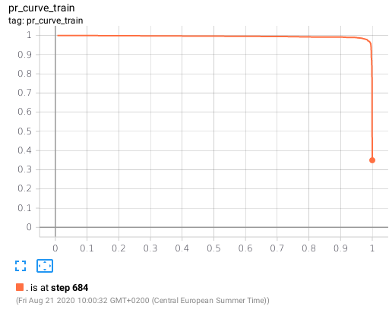
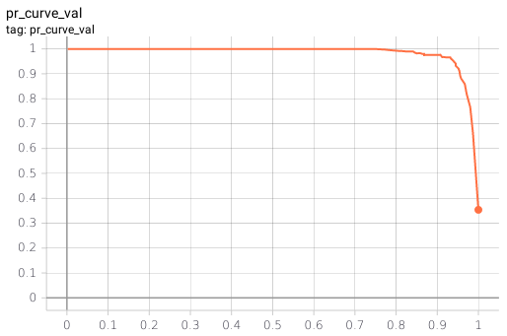
Improving the model: precision-recall curves

Slide 36
Inference on wk data
Model input shape = (140, 140, 1), output_shape = (1, 1, 1)
predictions are sparse floats [0,1]
Sparse floats can be written to compressed wkw files (20 mb instead of 4 gb), rendering in webknossos works
Computational cost for predicting artifacts for a 1024³ raw data cube with stride=(35,35,1)
cpu: ~ 60 min @ gabag; 16 cores
gpu: ~ 5 min @ gabag; tesla v100
Mag8-8-1 of Meike’s scMS109_1to7199 is comprised of ~ 3500 cubes:
cpu: 3500 * 60/60 * 16 = 65,000 core hours
gpu: 3500 * 5/60 = 290 gpu hours

Slide 37
Inference on wk data: examples
The good
Circular artifact
https://webknossos.brain.mpg.de/datasets/Connectomics_Department/2018-11-13_scMS109_1to7199_v01_l4_06_24_fixed_mag8_artifact_pred/view#20952,15727,1336,0,0.467
Fold
https://webknossos.brain.mpg.de/datasets/Connectomics_Department/2018-11-13_scMS109_1to7199_v01_l4_06_24_fixed_mag8_artifact_pred/view#20725,15822,1362,0,0.467
Horse shoe
https://webknossos.brain.mpg.de/datasets/Connectomics_Department/2018-11-13_scMS109_1to7199_v01_l4_06_24_fixed_mag8_artifact_pred/view#20686,15980,1380,0,0.319
The bad & ugly
Myelin (bad)
https://webknossos.brain.mpg.de/datasets/Connectomics_Department/2018-11-13_scMS109_1to7199_v01_l4_06_24_fixed_mag8_artifact_pred/view#20795,15782,1389,0,0.263
Blood vessel (bad)
Not covered by current predictions but known from previous experience

Slide 38
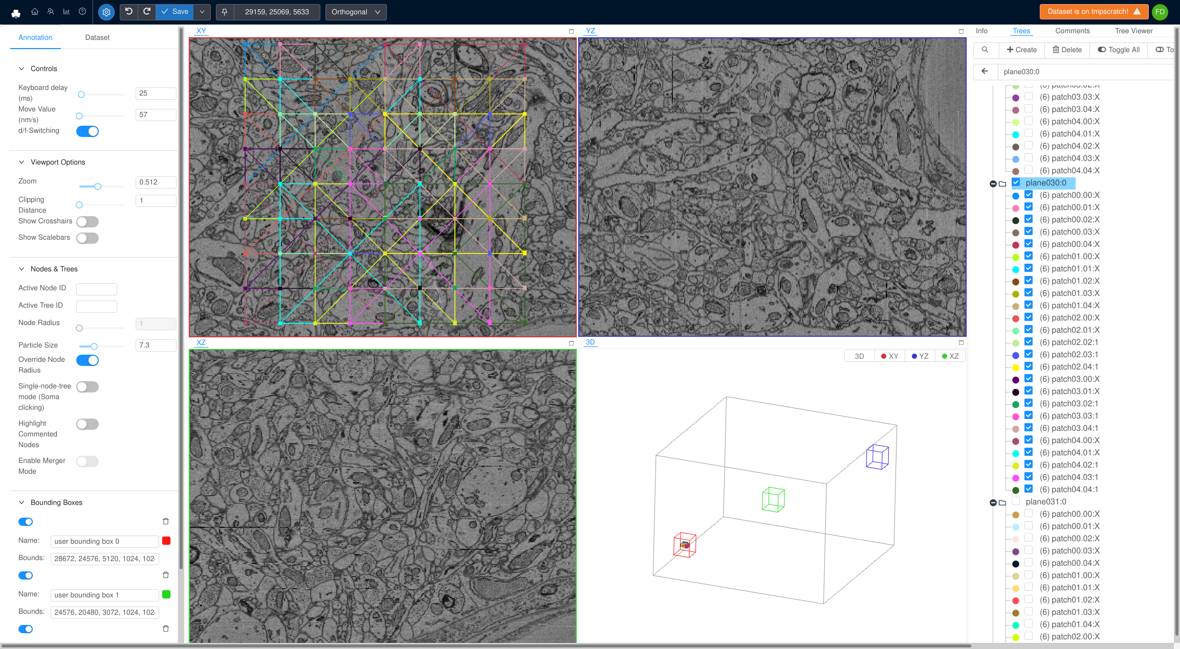
Inference on wk data: test data evaluation
3 distributed test boxes, each (10x10x2) um³
Used skeleton tracing for classification: Each prediction patch indicated by tree, all patch trees of one plane are part of one tree group
-> comment hierarchy labels patches

Slide 39
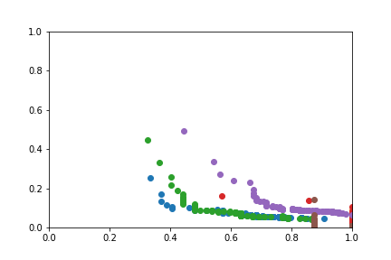
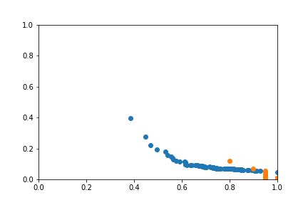
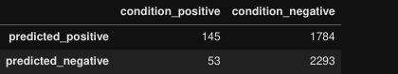
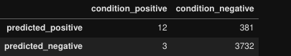
Inference on wk data: test data evaluation
Pred test boxes separate
Pred test boxes combined
Precision = tp/(tp+fp) = 145/(145+1784) = 0.10
Recall = tp/(tp+fn) = 145/(145+53) = 0.73
Precision = tp/(tp+fp) = 12/(12+381) = 0.03
Recall = tp/(tp+fn) = 12/(12+3) = 0.80

Slide 40
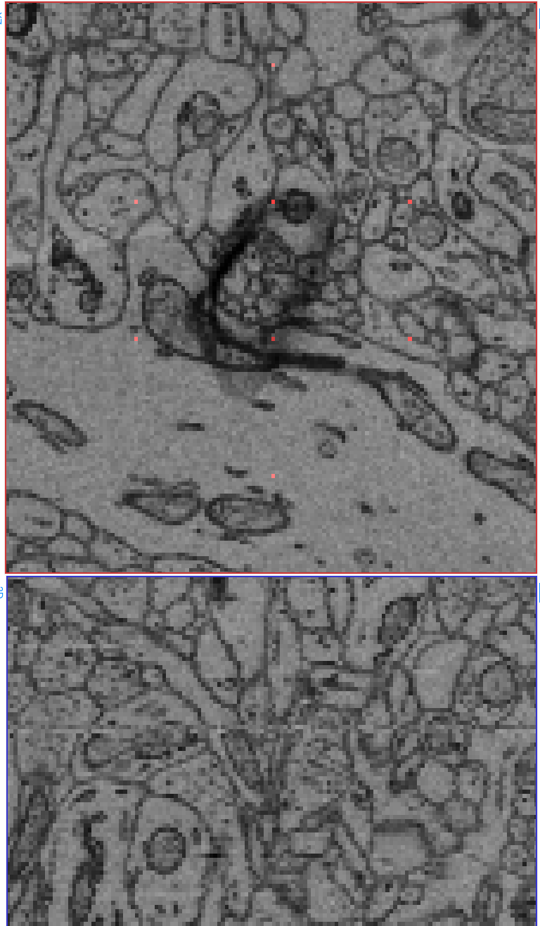
Inference on wk data: test data evaluation
What we know about artifacts:
Even small artifact spread (focally, xy-plane) over multiple prediction patches
However, artifacts don’t extend over multiple planes (axially). Instead, positive predictions extending over multiple planes might correspond to blood vessels, myelin etc.
-> apply this geometrical prior to sparse predictions
pred_filt = pred * kernel
kernel = array([
[
[-0.025, -0.05 , -0.025],
[-0.05 , -0.2 , -0.05 ],
[-0.025, -0.05 , -0.025]
],[
[0.125, 0.25 , 0.125],
[ 0.25, 0.5 , 0.25 ],
[0.125, 0.25 , 0.125]
],[
[-0.025, -0.05 , -0.025],
[-0.05 , -0.2 , -0.05 ],
[-0.025, -0.05 , -0.025]
]])
Problem: smears out bimodal probability distribution
Instead: Morphological operations?

Slide 41
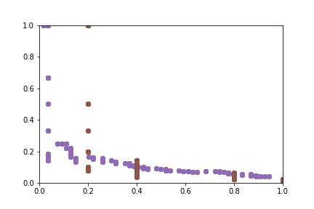
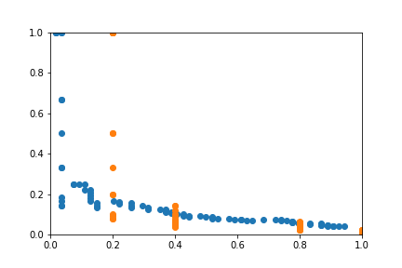
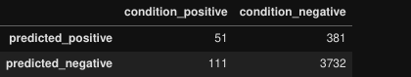
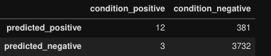
Inference on wk data: test data evaluation
Pred filtered test boxes separate
Pred filtered test boxes combined
Precision = tp/(tp+fp) = 51/(51+381) = 0.12
Recall = tp/(tp+fn) = 51/(51+111) = 0.31
Precision = tp/(tp+fp) = 12/(12+381) = 0.03
Recall = tp/(tp+fn) = 12/(12+3) = 0.80

Slide 42
Inference on wk data: Todo
-> Explain extreme performance drop
Validate by running inference on traindata
If train metrics reproducible using inference code (model weight loading etc.):
Problem could be real
Rooted in actual encoding + classification performance
-> re-train network with much more artifact-free data
Problem could be pseudo
Unexpected cause
-> strange effect of batch norm
-> inference bug
-> metrics bug

Slide 43
Ali Karimi
Alessandro Motta
Meike Sievers
Jakob Strahle
Manuel Berning
Benedikt Staffler
Emmanuel Klinger
Martin Schmidt
Yagmur Yener
Sahil Loomba
Anjali Gour
Abdelrahman Khalifa
Helene Schmidt
Vijay Gangadharan
Kun Song
Zhihui Feng
Kevin Boergens
Yunfeng Hua
Philip Laserstein
Philip Bastians
Moritz Helmstaedter
Gilles Laurent
Johannes Letzkus
Sylvia Krauss-Fernando
Iris Wolf
Lev Dadashev
Selina Horn
Smaro Soworka
Heiko Wissler
Thanks :)

Slide 44
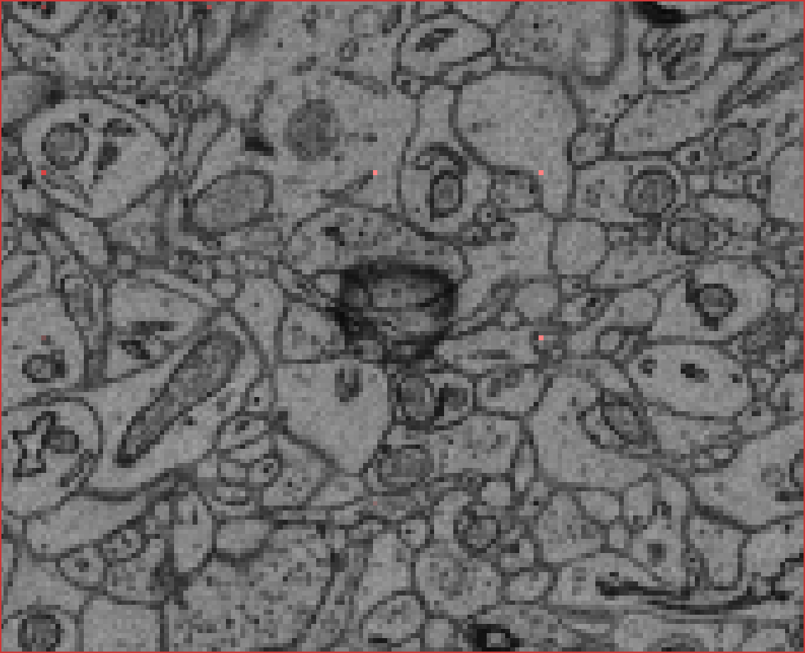
Appendix: Qualitative observations prediction quality
Observation
Prediction peak not centered on artifact
Possible cause
Artifact class not represented robustly enough in traindata (e.g. represented with low n + off-center)
Possible alleviation
Increase availability in traindata
Add more (e.g. selectively for certain artifact size ranges)
Augment more (current wiggling with stride 35)
https://webknossos.brain.mpg.de/annotations/Explorational/5f5622a401000010004af1c6#29133,25108,5630,0,0.200,8034

Slide 45
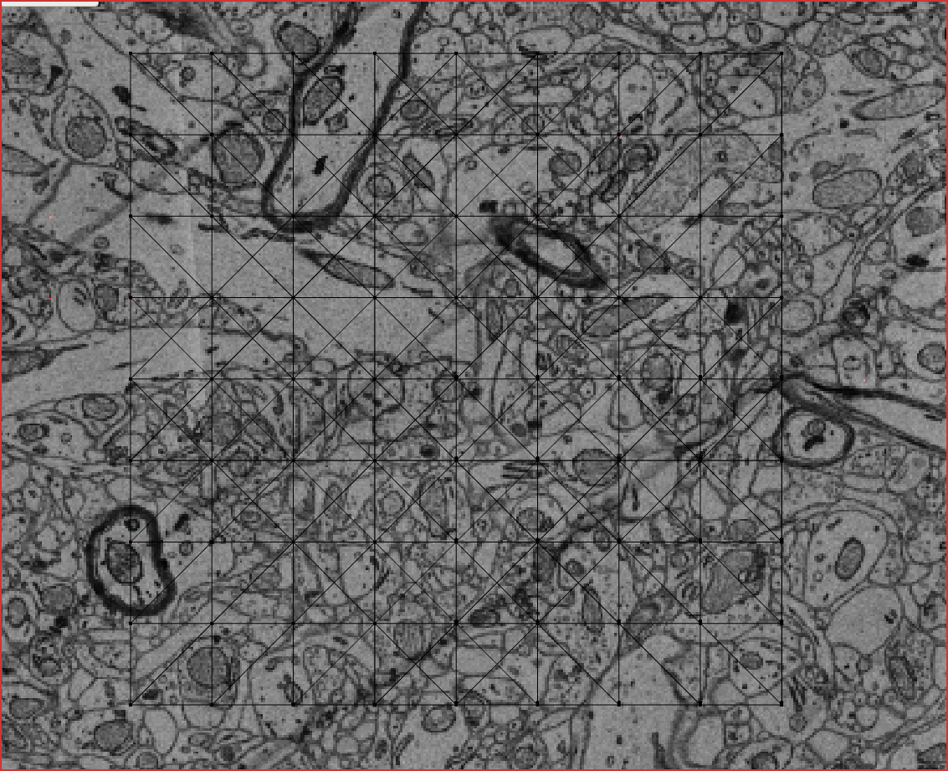
Appendix: Ground truth for raw data fringe cases
Artifact or no artifact?
Equidistant dark stripes
https://webknossos.brain.mpg.de/annotations/Explorational/5f569d4001000050004afa25#20970,15849,1540,0,0.360

Slide 46
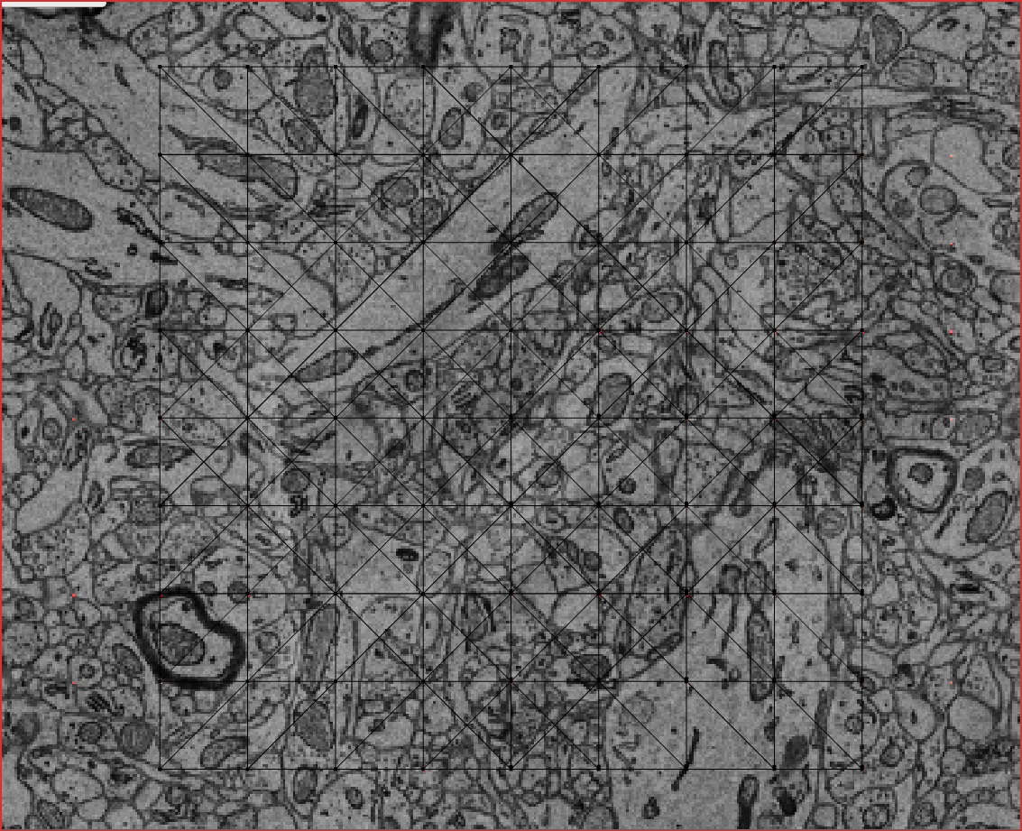
Appendix: Ground truth for raw data fringe cases
Artifact or no artifact?
Brightness variation
https://webknossos.brain.mpg.de/annotations/Explorational/5f569d4001000050004afa25#20970,15849,1540,0,0.360

Slide 47
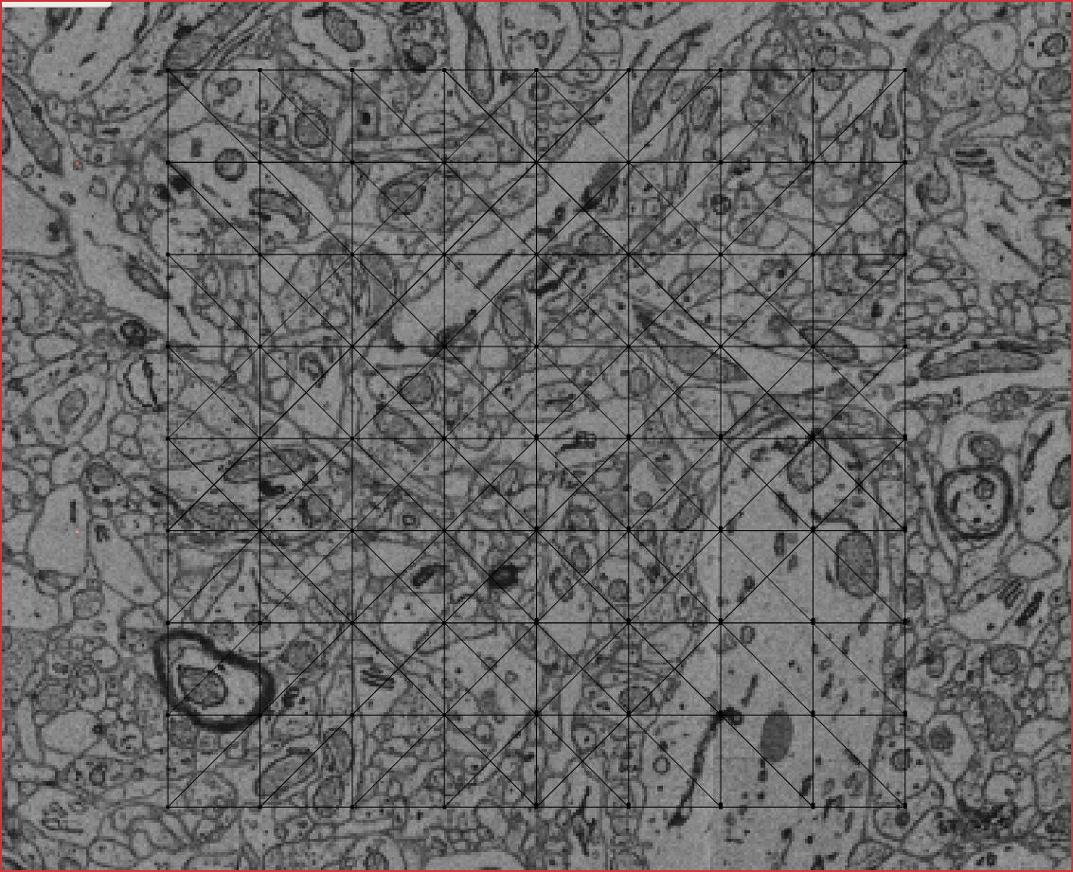
Appendix: Ground truth for raw data fringe cases
Artifact or no artifact?
Out of focus
https://webknossos.brain.mpg.de/annotations/Explorational/5f569d4001000050004afa25#20970,15849,1552,0,0.360

